Slide 1
CSCI 558L Lecture 3: Computer Networking and Ethernet
Internetworking and Distributed Systems Laboratory
Young Cho
Department of Computer Science
University of Southern California
Slides adopted from Berkeley and Rice

Slide 2

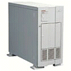
Lost Packets
Problem: Lost Data
GET index.html
Internet
Solution: Timeout and Retransmit
GET index.html
GET index.html
Internet
GET index.html

Slide 3
Large Data
Problem: Packet size
On Ethernet, max IP packet is 1.5kbytes
Typical web page is 10kbytes
Solution: Fragment data across packets
ml
x.ht
inde
GET
GET index.html

Slide 4
Out of Order Packets
Problem: Out of Order
ml
inde
x.ht
GET
GET x.htindeml
Solution: Add Sequence Numbers
ml
4
inde
2
x.ht
3
GET
1
GET index.html

Slide 5
Lots of Functions Needed
Link
Multiplexing
Routing
Addressing/naming (locating peers)
Reliability
Flow control
Fragmentation
Etc….

Slide 6
What is Layering?
Modular approach to network functionality
Example:
Application
Application-to-application channels
Host-to-host connectivity
Link hardware

Slide 7
Protocols
Module in layered structure
Set of rules governing communication
Applications
Hosts
Routers
Protocols define:
Interface to higher layers (API)
Interface to peer
Format and order of messages
Actions taken on receipt of a message
Notes:
Human analogy – social customs

Slide 8
Layering Characteristics
Services
Each layer relies on services from layer below
Each layer exports services to layer above
Provides interface that defines interaction
Modularity
Hides implementation
Layers can change without disturbing other layers (black box)

Slide 9
Layering
User A
User B
Application
Transport
Network
Link
Host
Host
Layering: technique to simplify complex systems

Slide 10
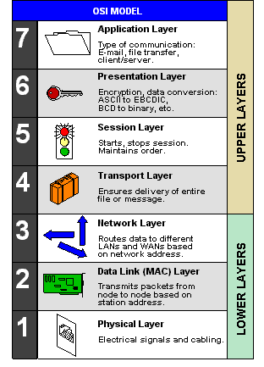
Open System Interconnection Reference Model
From computer desktop encyclopedia © 2004

Slide 11
Lower Layers Networking
Physical Layer
Types of physical links
Configurations and scalability
Arbitration/Control of Medium
Transmitting with address
Fairness and Performance on Transmission
Network Layer
Routing over heterogeneous networks

Slide 12
Physical Layer
Types of Links
Wires/Wireless
Optics, Copper, Acoustics, RF and etc.
Configurations
Bus, Ring, Star, and etc.
Bandwith/Latency/Cost
Scalability
Composition
Maximum number of nodes

Slide 13
Medium Access Control
Fixed assignment
Each node gets a slice of the bandwidth
Examples: TDMA, FDMA, CDMA
popular in wireless devices
Reservation-based
Reserve the channel when using
Example: Token Ring
Contention-based
Nodes contend and recover from collisions
Examples: Aloha, Ethernet

Slide 14
OSI Layers and Locations
Application
Presentation
Session
Transport
Network
Data Link
Physical
Host
Switch
Router
Host

Slide 15
Layer Encapsulation
User A
User B
Get index.html
Connection ID
Source/Destination
Link Address

Slide 16
Remnants of Layering
Redundancy
Layer N may duplicate lower level functionality (e.g., error recovery)
Layers may need same info (timestamp, MTU)
Consequences
For assurance and guarantee
May hurt performance

Slide 17
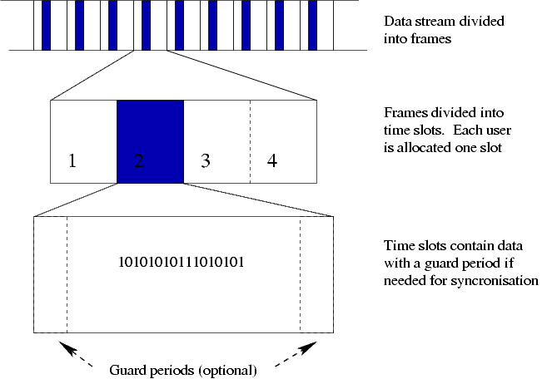
Time Division Multiple Access
from wikipedia

Slide 18
Token Ring
IBM in early 80’s as a new LAN architecture
Nodes connected into a ring
Special message called a token is passed around
When nodes gets the token it can transmit for a time
Every node gets an equal opportunity to send
IEEE 802.5 standard for Token Ring
Predictability, fairness and reliability
Designed to run at either 4Mbps and 16Mbps
Still used but beaten out by Ethernet

Slide 19
Aloha Packet Radio Network
Computing
Center
413 MHz
413 MHz
407 MHz
407 MHz
Campus A
Throughput 9600 bps
Frame Size 704 bits
Campus B
Early RF broadcast network developed at University of Hawaii1970
Designed to interconnect 7 campuses of the U of H
Central Computing Center served as hub
Senders send the data when necessary
Receiver sends an ACK for data, Timeout for ACK signals that there was a collision
When collision, sender will resend data after a random back-off time
Utilization (fraction of transmitted frames avoiding collision for N nodes)
Max utilization = 18%
Slotted Aloha (dividing transmit time into windows)
Max utilization increased to 36%

Slide 20
Focus: Ethernet
History
Developed by Bob Metcalfe at Xerox PARC in mid-1970s
Roots in Aloha packet-radio network
Standardized by Xerox, DEC, and Intel in 1978
LAN standards define MAC and physical layer connectivity
IEEE 802.3 (CSMA/CD - Ethernet) standard – originally 2Mbps
IEEE 802.3u standard for 100Mbps Ethernet
IEEE 802.3z standard for 1,000Mbps Ethernet
IEEE 802.3ax-xxxx standard for 10Gbps Ethernet
CSMA/CD: Ethernet’s Media Access Control (MAC) policy
CS = carrier sense
Send only if medium is idle
MA = multiple access
CD = collision detection
Stop sending immediately if collision is detected

Slide 21
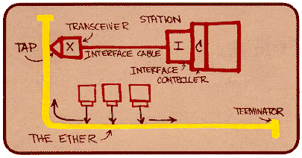
Ethernet Standard
802.3 standard defines both MAC and physical layer
Metcalfe’s original Ethernet Sketch

Slide 22
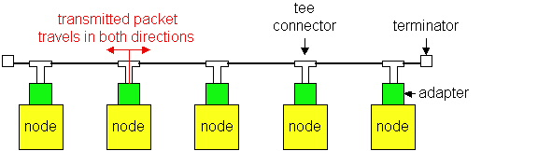
Ethernet Technologies: 10Base2
10: 10Mbps; 2: under 185 (~200) meters cable length
Thin coaxial cable in a bus topology
Repeaters used to connect multiple segments
Repeater repeats bits it hears on one interface to its other interfaces: physical layer device only!

Slide 23
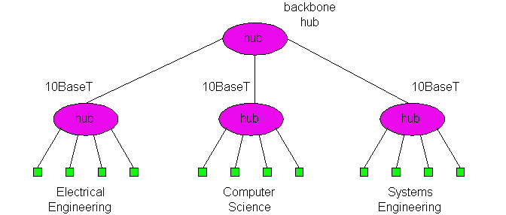
10BaseT and 100BaseT
10/100 Mbps rate
T stands for Twisted Pair
Hub(s) connected by twisted pair facilitate “star topology”
Distance of any node to hub must be < 100M

Slide 24
Physical Layer Configurations for 802.3
Data rate (10Mbps-10Gbps)
Signaling method (base, broad)
Baseband: Digital signaling
Broadband: Analog signaling
Cabling (2, 5, T, F, S, L)
5 - Thick coax (original Ethernet cabling)
F – Optical fiber
S – Short wave laser over multimode fiber
L – Long wave laser over single mode fiber

Slide 25
Ethernet Overview
Most popular packet-switched LAN technology
Bandwidths: 10Mbps-10Gbps
40-100 Gbps in the works (draft stage)
Products being developed and announced (Juniper)
Testing equipments (Ixia, Spirent, Agilent, and etc.)
Bus length
Traditionally 500m segments with 4 repeaters
Depends on PHY
Bus and Star topologies are used to connect hosts
Hosts attached via Ethernet transceiver or hub or switch
Detects line state and sends/receives signals
Hubs are used to facilitate shared connections
All hosts on an Ethernet are competing for access
Switches
Breaks the original model
Used by most higher speed Ethernet (1+ Gbps)
Ethernet by definition is a broadcast protocol
Any signal can be received by all hosts
Switching enables individual hosts to communicate

Slide 26
Switched Ethernet
Switches forward frames based on MAC addresses
Not a bus
Simple forwarding tables are maintained
Highly Scalable
Options for many interfaces
Full duplex operation (send/receive frames simultaneously)
Connect 2+ “segments” by copying data frames
Switches only copy data when needed (less overhead over repeaters)
Higher link bandwidth
No Collisions at each links
Port can have contention (buffers are used)
Much greater aggregate bandwidth
Separate segments can send at once

Slide 27
Ethernet Frames
Network layer packets are transmitted by encapsulating
Preamble is a sequence of 7 bytes, each set to “10101010”
Used to synchronize receiver before actual data is sent
Medium Access Control Addresses
unique, 48-bit unicast address assigned to each adapter
example: 8:0:e4:b1:2
Each manufacturer gets their own address range
broadcast: all 1s
multicast: first bit is 1
Type field
Key to indicate higher level protocol
Body can contain up to 1500 bytes of data
Jumbo packets go up to 9000 bytes
64
48
48
16
32
Preamble
Dest
Src
Type
Body
CRC
addr
addr

Slide 28
Ethernet’s MAC Algorithm
Different from Aloha
Aloha sent packets regardless of others
Long distances and different communication coverage
Ethernet uses Carrier Sense Multiple Access CSMA/CD
Listens to line before/during sending
CD – Collision Detection
Not CA – Collision Avoidance (Radio Spectrum)
If line is idle (no carrier sensed)
send packet immediately
upper bound message size of 1500 bytes
must wait 9.6us between back-to-back frames
If line is busy (carrier sensed)
wait until idle and transmit packet immediately
If collision detected
Stop sending and jam signal
Try again later

Slide 29
State Diagram for CSMA/CD
Packet?
No
Sense Carrier
Send
Detect Collision
Discard Packet
Jam channel b=CalcBackoff(); wait(b);
attempts++;
attempts < 16
attempts == 16

Slide 30
Collisions
Collisions are caused when two adaptors transmit at the same
time (adaptors sense collision based on voltage differences)
Both found line to be idle
Both had been waiting to for a busy line to become idle
A starts at
time 0
A
B
Message almost
there at time T when
B starts – collision!
A
B
How can we be sure A knows about the collision?

Slide 31
Collision Detection
How can A know that a collision has taken place?
There must be a mechanism to insure retransmission on collision
A’s message reaches B at time T
B’s message reaches A at time 2T
So, A must still be transmitting at 2T
IEEE 802.3 specifies max value of 2T to be 51.2us
This relates to maximum distance of 2500m between hosts
At 10Mbps it takes 0.1us to transmit one bit so 512 bits (64B) take 51.2us to send
So, Ethernet frames must be at least 64B long
14B header, 46B data, 4B CRC
Padding is used if data is less than 46B
Send jamming signal after collision is detected to insure all hosts see collision
48 bit signal

Slide 32
Exponential Backoff
If a collision is detected, delay and try again
Delay time is selected using binary exponential backoff
1st time: choose K from {0,1} then delay = K * 51.2us
2nd time: choose K from {0,1,2,3} then delay = K * 51.2us
nth time: delay = K x 51.2us, for K=0..2^{n} – 1
Note max value for k = 1023
give up after several tries (usually 16)
Report transmit error to host
If delay were not random, then there is a chance that sources would retransmit in lock step
Why not just choose from small set for K
This works fine for a small number of hosts
Large number of nodes would result in more collisions

Slide 33
Experiences with Ethernet
Ethernets work best under light loads
Utilization over 30% is considered heavy
Network capacity is wasted by collisions
Most networks are limited to about 200 hosts
Specification allows for up to 1024
Most networks are much shorter
5 to 10 microsecond RTT
Transport level flow control helps reduce load (number of back to back packets)
Ethernet is inexpensive, fast and easy to administer!

Slide 34
Fast and 1+ Gigabit Ethernet
Fast Ethernet (100Mbps) has technology very similar to 10Mbps Ethernet
Uses different physical layer encoding (4B5B)
Many NIC’s are 10/100 capable
Can be used at either speed
1 Gigabit Ethernet
Compatible with lower speeds
Uses standard framing and CSMA/CD algorithm
Distances are severely limited
Commoditized (integrated on to the motherboards)
What are the bandwidth limitation? True 1Gbps?
10+ Gigabit Ethernet
Mostly incompatible with lower speeds
Special PHY needed
Cost is going down for 10Gbps (~$500-$1000/NIC)
Expensive appliances

Slide 35
Ethernet Problems
Ethernet’s peak utilization is pretty low
Peak throughput worst with
More hosts
More collisions needed to identify single sender
Smaller packet sizes
More frequent arbitration
Longer links
Collisions take longer to observe, more wasted bandwidth
Efficiency is improved by avoiding these conditions

Slide 36
Ethernet: The Network of Choice
Low Price
Lots of Support
Performance
High Availability
Ease of use
High Scalability
Historical

Slide 37
Minimalist Approach for Higher Level
Dumb network
IP provide minimal functionalities to support connectivity
Addressing, forwarding, routing
Smart end system
Transport layer or application performs more sophisticated functionalities
Flow control, error control, congestion control
Advantages
Accommodate heterogeneous technologies (Ethernet, modem, satellite, wireless)
Support diverse applications (telnet, ftp, Web, X windows)
Decentralized network administration

Slide 38
Next
Next Lecture: Internet Protocol
Post Your Group Information
Project Group Forum
Laboratory 2
Socket Programming Tutorial
Due September 6, 2012 at 11:55pm
Reading Assignment
Narten, T., "Internet Routing", ACM SigCom 89.
4 powerpoint/pdf slides
1 title slide, 2 summary slides, 1 Q&A slide
Summarizing the content of the paper (include at least 1 hand drawn picture by you to describe each slide).
Also make one slide containing one exam question and answer based on the main concept of the paper. Please turn the slides in by September 8, 2012 11:55pm for a full credit.

